Slide 1
Computer Graphics (L13) EG678EX
Illumination Models & Surface Rendering Methods

Slide 2
Background
Perspective Projection + Natural Lighting Effects to Visible Surface 🡪 Realistic Effect in Scene
Illumination model (Shading Model) is used to Calculate intensity of light that we see at a given point on the surface of an object
Surface Rendering algorithm uses the intensity calculation from an illumination model to determine the light intensity of all pixel positions for various surfaces in the scene
Photorealism in computer graphics involves two elements:
Accurate graphical representations of object
Good physical descriptions of lighting effect in scene
Illumination model: derived from physical laws that describe surface light intensities

Slide 3
Light Sources
Luminous objects
Light Emitting Sources
Reflecting Sources
Point Source: Simplest model of light emitter
Distributed Light Source: modeled as accumulated illumination effects of the points over the surface of the source

Slide 4
Basic Illumination Model
Ambient Light 🡪 Background Light
Object not exposed directly to a light source is visible with ambient light
Has no spatial or directional characteristics
Amount of ambient light incident on each object is a constant for all surfaces and over all directions
Level for the ambient light in scene by parameter I_{a}
Each surface in the scene is illuminated with the constant intensity level I_{a}
The intensity of reflected light (intensity of illumination) depends upon optical properties of the surface
Ambient light produces flat shading 🡪 not desirable in general, so scenes are illuminated with other light source together with ambient light

Slide 5
Basic Illumination Model
Diffuse Reflection
Reflected light intensity are constant over each surface in a scene independent of viewing direction 🡪 ideal diffuse reflectors
the diffuse-reflection coefficient (diffuse reflectivity) 🡪 k_{d}
Sets the fraction of light intensity that is reflected from each surface
k_{d} is a the function of surface color, but for our purpose we assume k_{d} to be constant
Diffuse reflection intensity when scene illuminated only with ambient light:
I_{ambdiff} = k_{d}I_{a}
Lambertian reflectors
Follow lambart’s cosine law 🡪 radiant energy from a small surface area dA is proportional to the cosine of angle θ between surface normal and incident light direction
For a point source with intensity I_{l}, the diffuse reflection intensity is
I_{l,diff} = k_{d}I_{l}cosθ
I_{l,diff} = k_{d}I_{l}(N.L)
Where N and L are unit vectors
N
L
θ

Slide 6
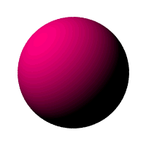

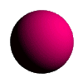
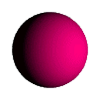
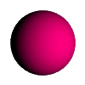
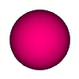
Basic Illumination Model
Diffuse reflection for ambient light source + a point light source
I_{diff} = k_{a}I_{a} + k_{d}I_{l}(N.L)
Fig:
sphere illuminated with different intensity ambient light
Illuminated with varying direction light source

Slide 7

Specular Reflection
Bright spot seen at an illuminated shiny surface when viewed at certain direction
Polished metal surface, person’s forehead, apple etc. exhibit specular reflection
In fact an image of light source
Result of total or near total reflection of incident light in a concentrated region around the specular reflection angle θ
Fig:
L 🡪 unit vector pointing to light source
N 🡪 unit surface normal vector
R 🡪 unit vector in direction of specular reflection
V 🡪 unit vector pointing viewer
Ideal reflector exhibit specelur reflection in the direction of R only (i.e Ø=0) but for non-ideal case specular reflection is seen over finite range of viewing positions
N
L
R
θ
θ
Ø
V

Slide 8
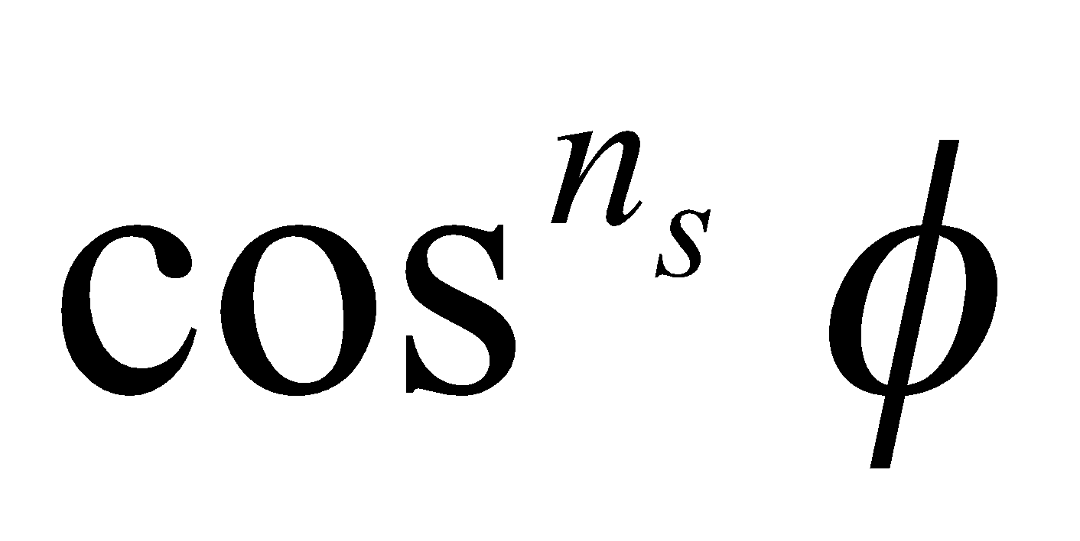
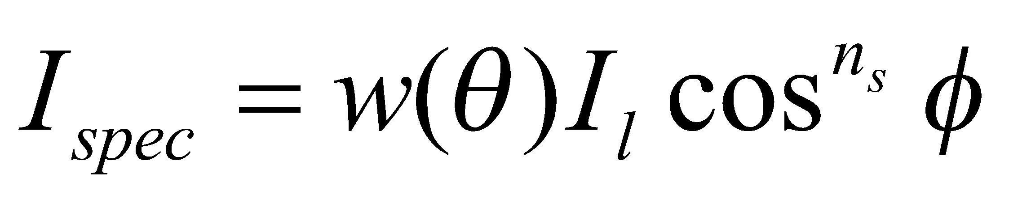
Phong Model
Intensity of specular reflection: proportional to
n_{s} 🡪 specular reflection parameter (depends on surface)
Ø ranges from 0 to 90⁰ (i.e cos Ø varies from 0 to 1)
Intensity of specular reflection depends on:
Material properties of surface
Angle of incidence θ
Other factors such as polarization and color of the incident light
Monochromatic specular intensity variations can be approximated using specular-reflection coefficient, w(θ) for each surface
At θ = 90⁰, w(θ) = 1 🡪 all incident light is reflected
N
L
R
θ
θ
Ø
V
N
L
R
N
L
R

Slide 9
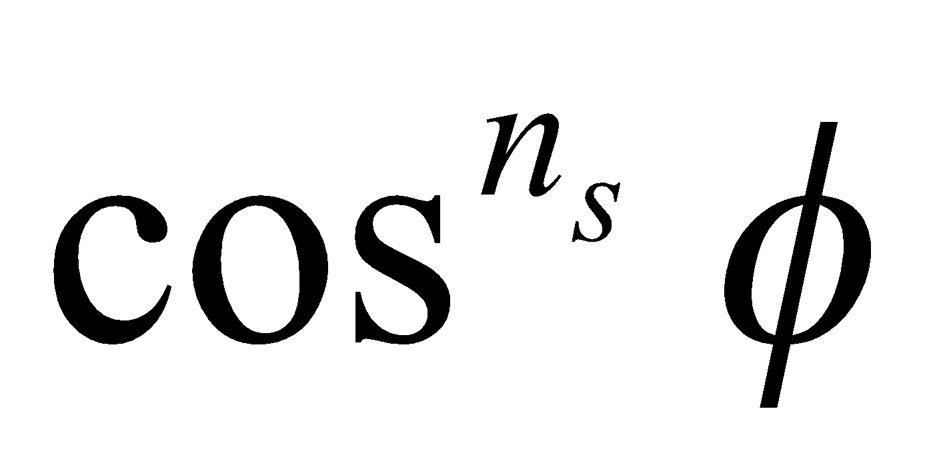
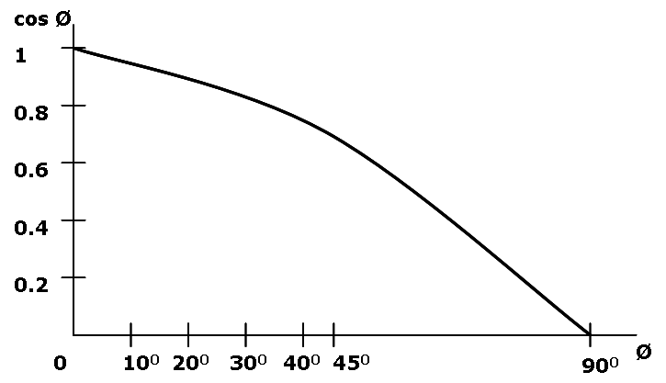
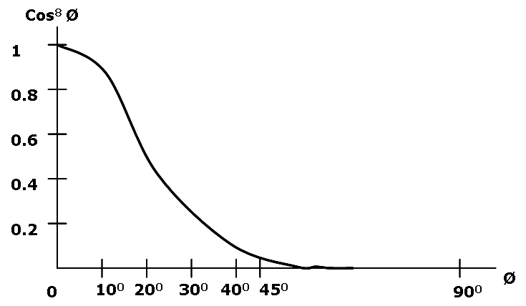
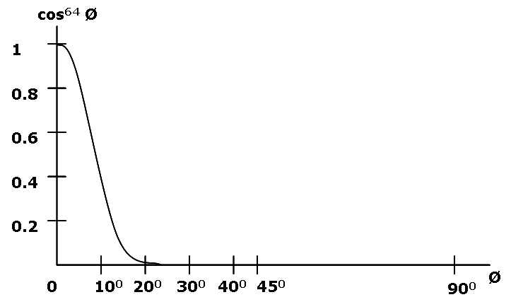
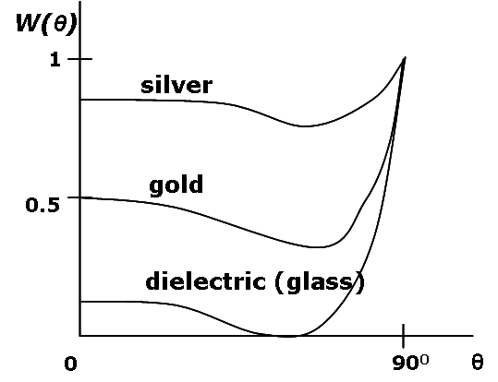
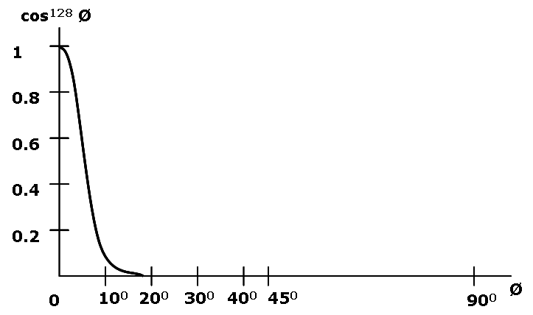
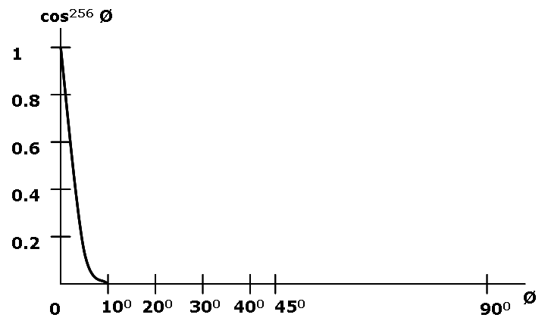
Plot For and Specular Reflection Coefficient For Various Materials

Slide 10
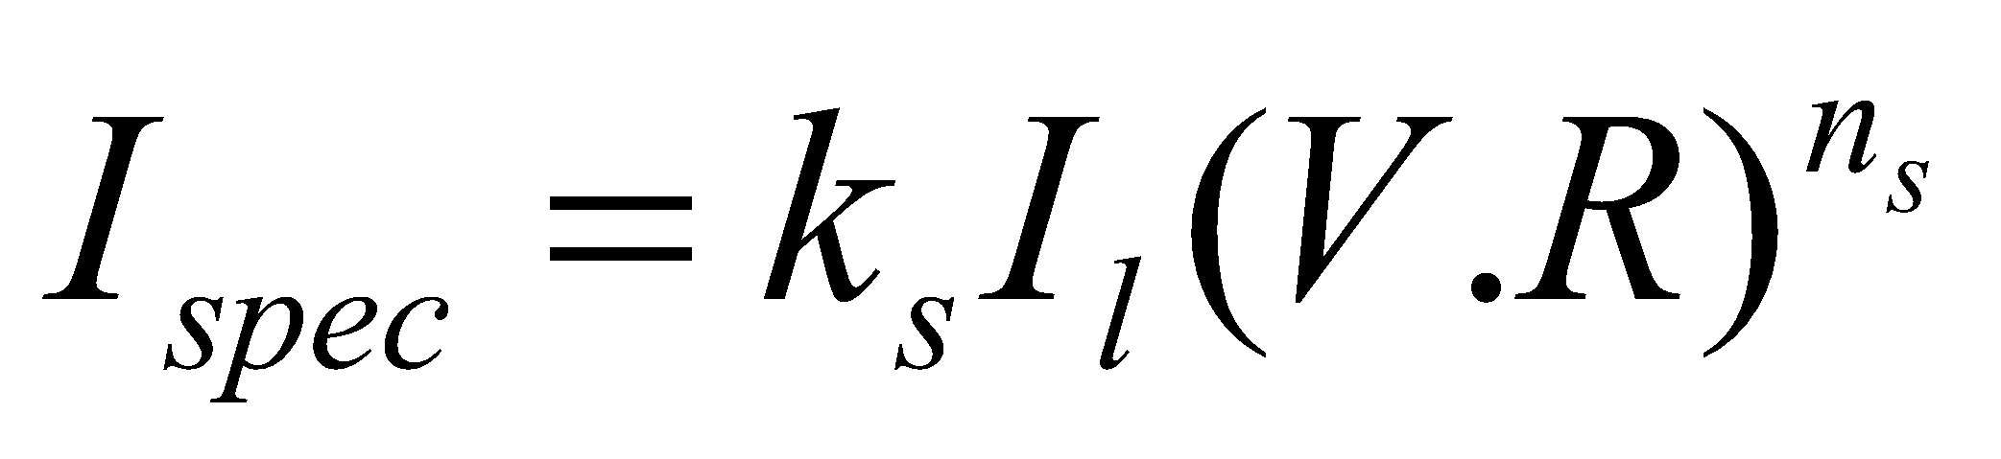
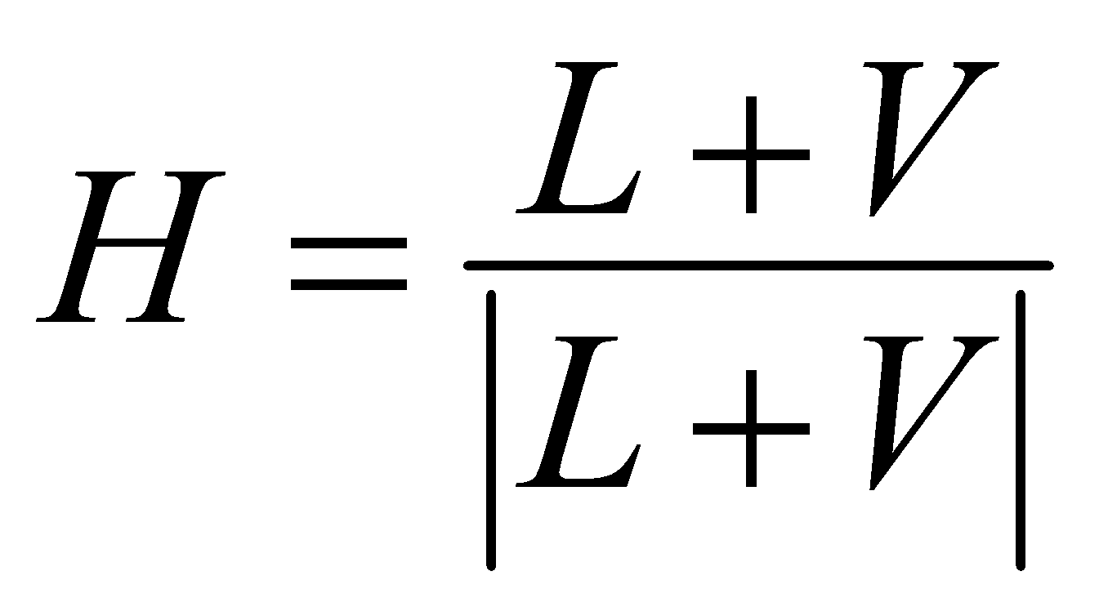
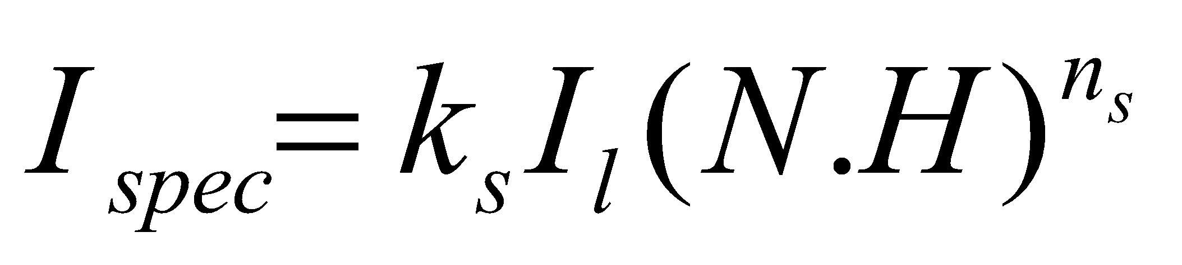
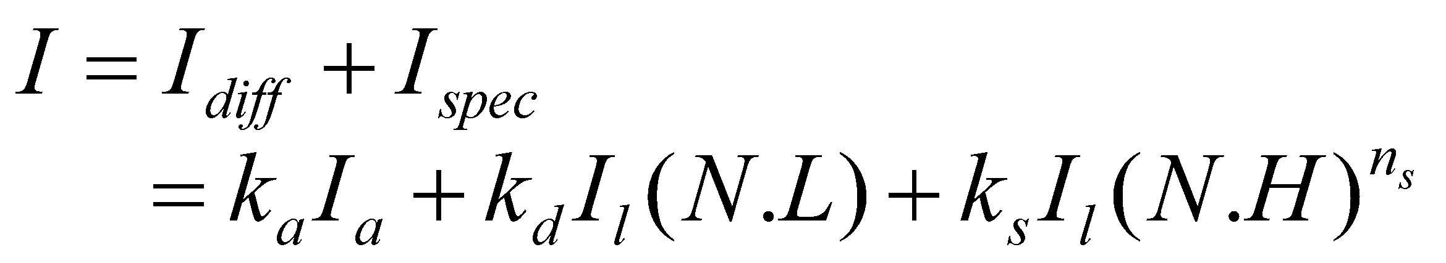
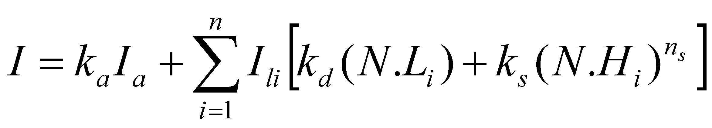
Phong Model (contd…)
Simplified form: assume w(θ) = k_{s} = constant
Vector R can be evaluated from vectors L an N as:
R + L = (2N.L)N
i.e R = (2N.L)N – L
Further simplified by replacing V.R with N.H where H is halfway vector between L and V (i.e H is unit bisector vector of angle between L and V)
Thus
If we add ambient light and diffuse reflection component then total intensity is given as:
For multiple light sources (n light sources)
L
L
N
R
N.L
L
N
H
R
α
Ø
V
When v is coplanar with L and R
α = Ø/2 otherwise α > Ø/2

Slide 11
Warn Model
Provides method for simulating studio lighting effects
Light intensities are controlled in different direction
Light sources are modeled as points on a reflecting surface using the Phong model for the surface points (i.e calculate intensities considering specular and diffuse reflection parameters). Then the intensity in different directions is controlled by selecting values for Phong exponent.
Light controls used by studio photographers can be simulated

Slide 12
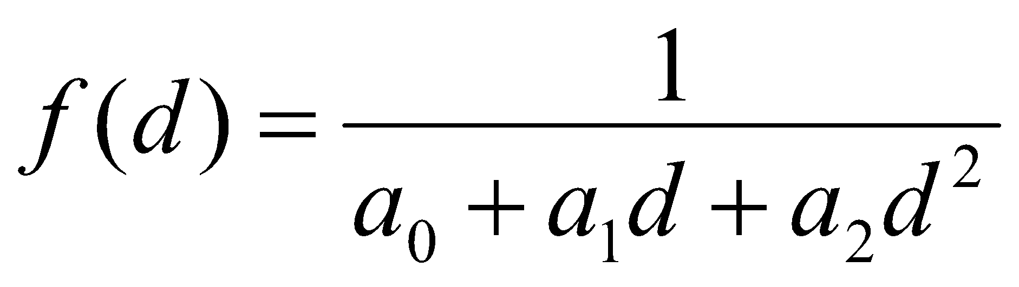
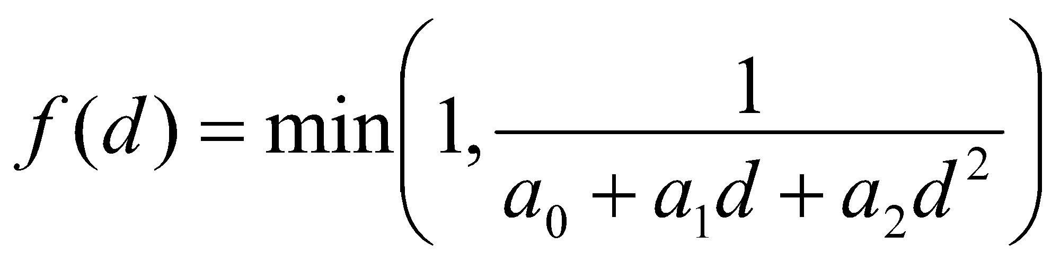
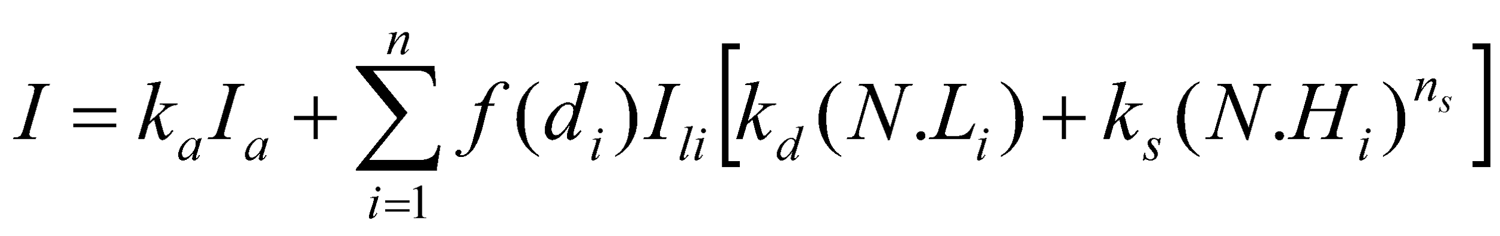
Intensity Attenuation
The intensity of radiant energy at a point d distance far from source is attenuated by 1/d²
Considering intensity attenuation produces realistic lighting effect
E.g: if two parallel surfaces with same optical parameters overlap, they would be displayed as one surface
Using merely 1/d² as attenuation factor for our simple single point light source model, too much intensity variation is produced when d is small and a little variation when d is large
Graphical packages have compensated the problem by using inverse linear quadratic function of d for intensity attenuation as:
a₀ can be adjusted to prevent f(d) from becoming too large when d is very small
Magnitude of attenuation function is limited to 1 as
The Phong illumination model considering attenuation is:

Slide 13
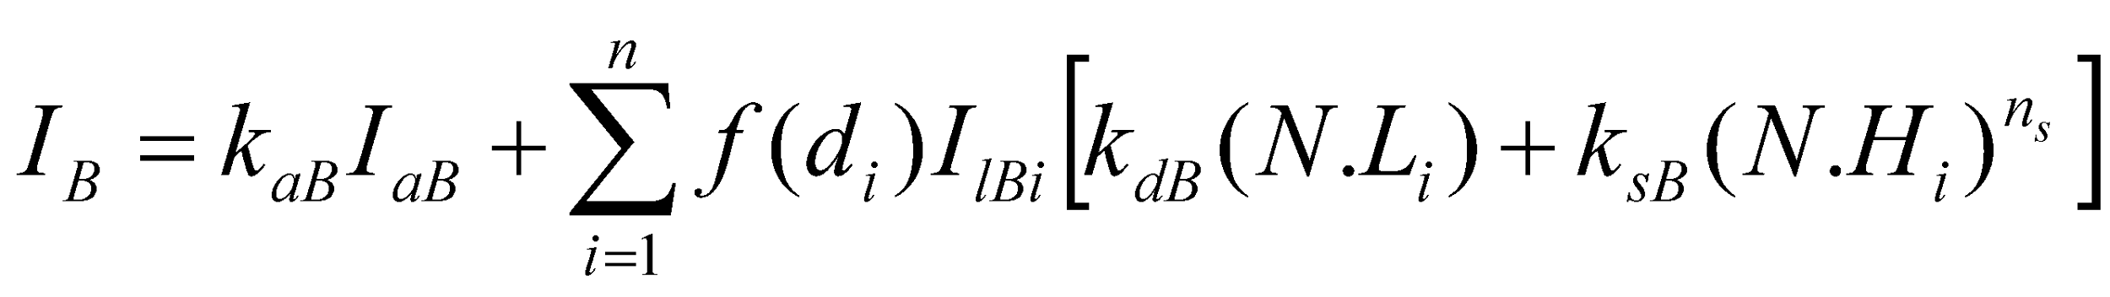
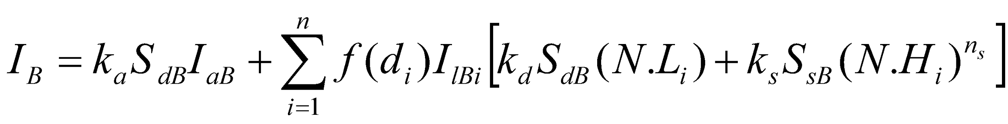
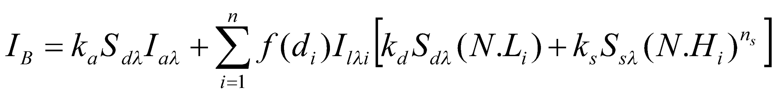
Color Consideration in Phong Illumination model
For RGB description, each color in a scene is expressed in terms of R,G and B components
Various methods:
Described by considering the RGB components for e.g. (k_{dR},k_{dG},k_{dB}) of diffuse reflection coefficient vector
E.g: For blue light (k_{dR}=k_{dG}=0)
Described by specifying components of diffuse and specular color vectors for each surface and retaining the reflectivity (k) as a single valued constants
Described by specifying wavelength for a color specification. This specification is useful to specify color as more than three components

Slide 14
Transparency
Transparent surface produces both reflected and transmitted light
Light intensity depends on relative transparency and position of light source or illuminated object behind or in front of the transparent surface
To model transparent surface, intensity contribution of light from various sources (illuminated objects) that are transmitted from the surface must be considered in the intensity equation
Both diffuse and specular reflection take place on transparent surface
Diffuse effects are important for partially transparent surfaces such as frosted glass
Diffuse refraction can be generated by decreasing the intensity of the refracted light and spreading intensity contributions at each point on the refracting surface onto a finite area to obtain blurred image of background surface
incident
light
transparent
object
air
glass
air
Incident
light

Slide 15
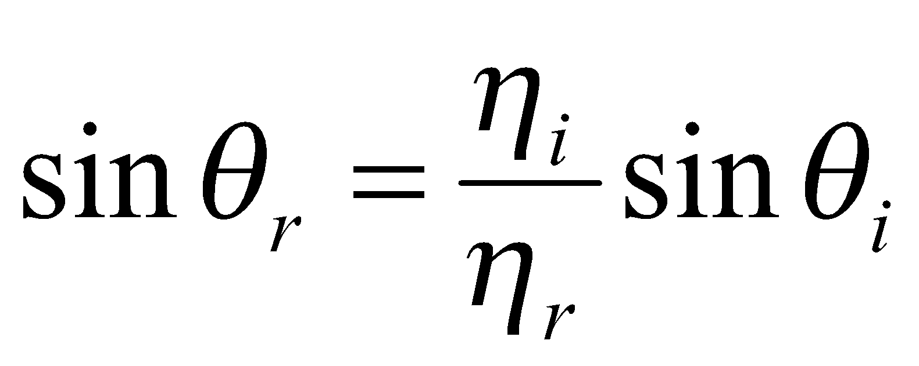
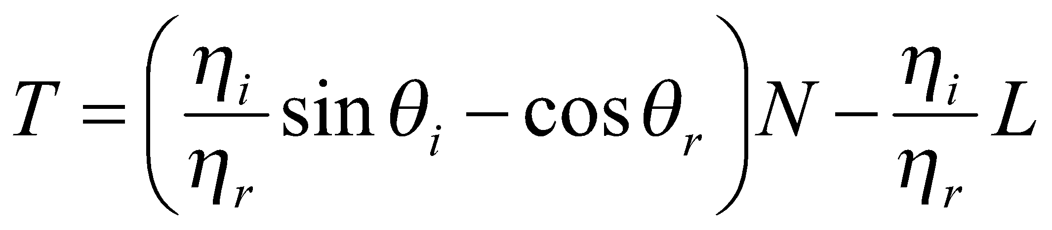
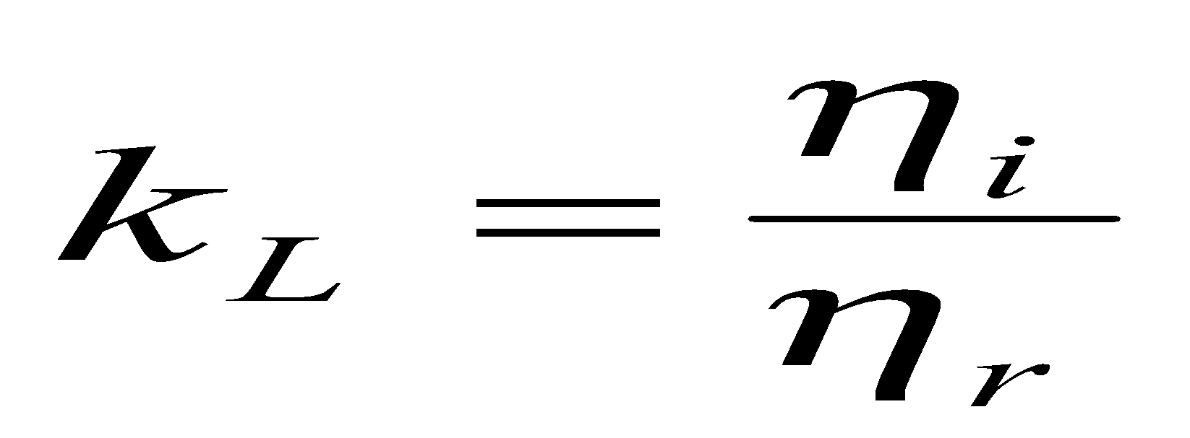
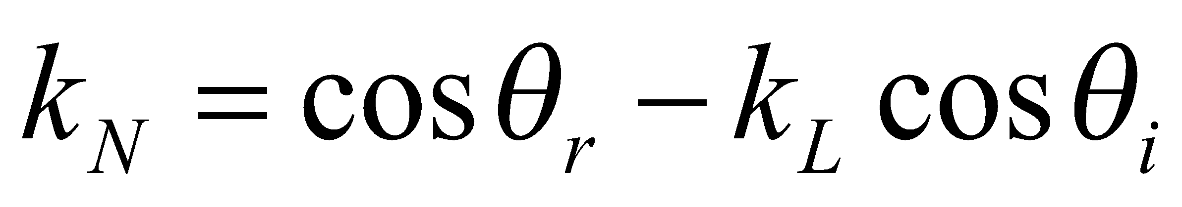

Transparency (contd…)
The Snell’s law is used to calculate the refracted ray direction
The unit vector along the transmitted light path is given by
Transmitted intensity I_{trans} through a transparent surface from a background object and Reflected intensity I_{refl} from the transparent surface with transparency coefficient k_{t} is given by
I = (1-k_{t})I_{refl} + k_{t}I_{trans}
where (1-k_{t}) is opacity factor
N
L
R
θ_{i}
θ_{i}
-k_{L}L
-k_{N}N
θ_{r}
T = -k_{L}L - k_{N}N
θ_{i}
T
background
object
P
transparent
object
Projection Plane

Slide 16
Shadow
Hidden surface method with light source at the view position can be used
The shadow area for all light sources are determined and these shadows could be treated as a surface pattern arrays
Light
direction

Slide 17
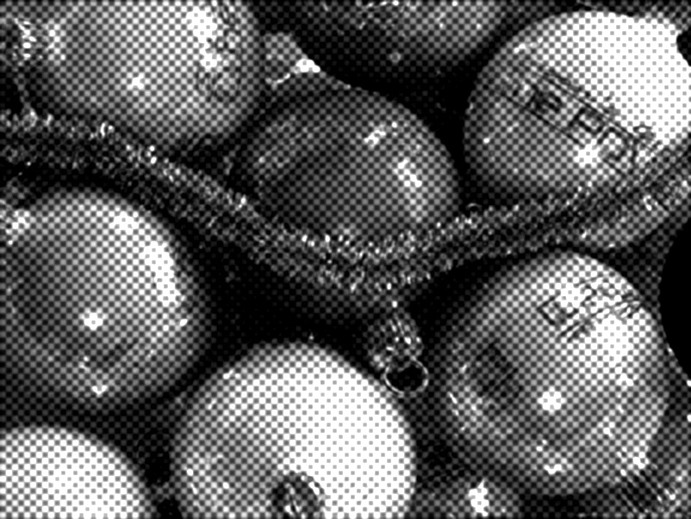
Displaying Light Intensities
The intensity calculated by illumination model must be converted to the allowable intensity of a particular graphics system
Graphics systems are bilevel (i.e two levels; on and off) and others are capable of displaying several levels
For the case of bilevel system, intensities are converted into halftone patterns
The difference between intensities 0.20 and 0.22 should be perceived same as that of 0.40 and 0.88
The intensity level in a monitor should be spaced so that the ratio of successive intensities is constant
for n+1 successive intensity levels
I₁/I₀=I₂/I₁=……..I_{n}/I_{n-1} = r
I_{k} = r^{k}I₀
also I_{n} = 1 🡪 r = (1/I₀)^{1/n}
so, I_{k} = I₀^{(n-k)/n}
The lowest intensity value I₀ depends on the characteristics of the monitor ( I₀ ranges from 0.005 to around 0.025)
the black level displayed on monitor will have some intensity
The highest intensity value is 1
For color system (blue color for example)
I_{Bk} = r_{B}^{k}I_{B0}

Slide 18
Polygon Rendering Methods
Illumination model is applied to fill the interior of polygons
Curved surfaces are approximated with polygon meshes
But polyhedra that are not curved surfaces are also modeled with polygon meshes
Two ways of polygon surface rendering
Single intensity for all points in a polygon
Interpolation of intensities for each point in a polygon
Methods:
Constant Intensity Shading
Gouraud Shading
Phong Shading

Slide 19
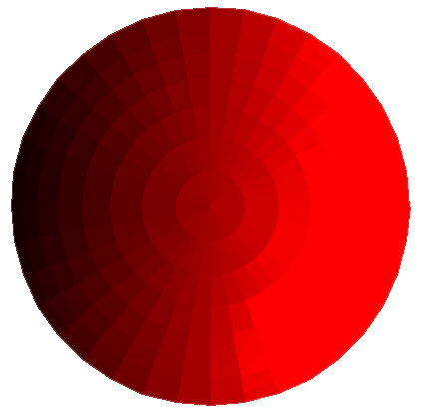
Constant Intensity Shading
Flat shading
Each polygon shaded with single intensity calculated for the polygon
Useful for displaying general appearance of a curved surface
Accurate rendering conditions:
Object is a polyhedron and not an curved surface approximation
All light sources should be sufficiently far from the surface (i.e N.L and attenuation function are constant over the polygon surfaces) :constant diffuse reflection??
Viewing position is sufficiently far (i.e V.R is constant over the surface) : Specular Reflection ??
Note: Approximate rendering is possible even the conditions are not satisfied
Drawback: intensity discontinuity at the edges of polygons
Credit goes to the students

Slide 20
Gouraud Shading
Calculation Steps:
Determine the average unit normal vector at each polygon vertex
Calculate each of the vertex intensities by applying an illumination model
Linearly interpolate the vertex intensities over the polygon surface
Intensity discontinuity at the edges of polygons is eliminated
Drawback:
Mach bands: bright and dark intensity streaks caused by linear interpolation of intensities
Could be reduced by dividing the surface into large number of polygons or by using other methods, such as Phong shading

Slide 21
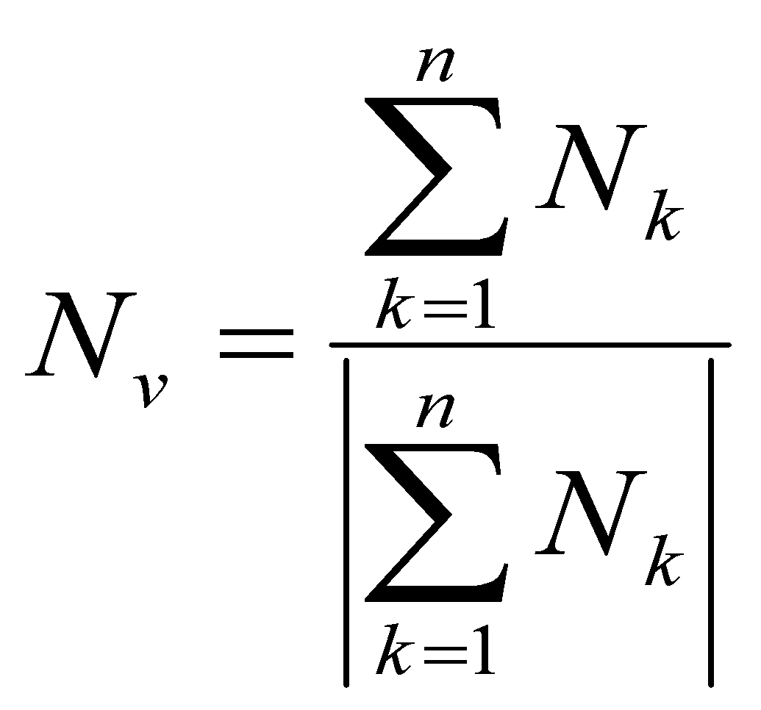
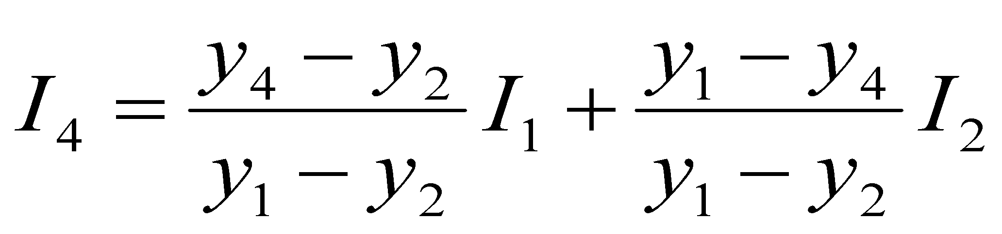
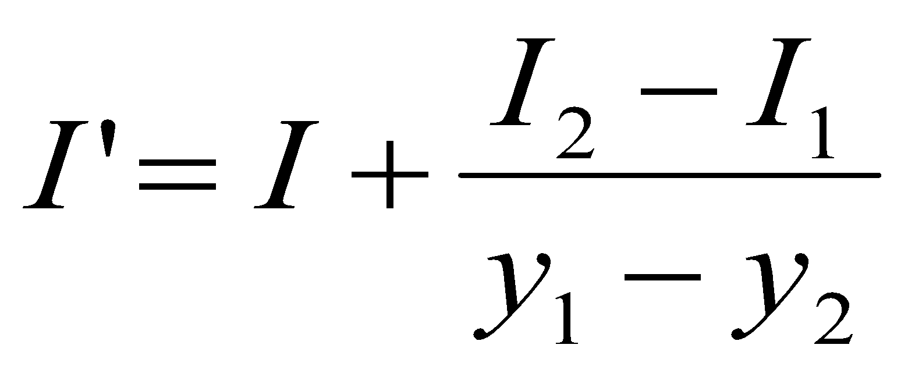
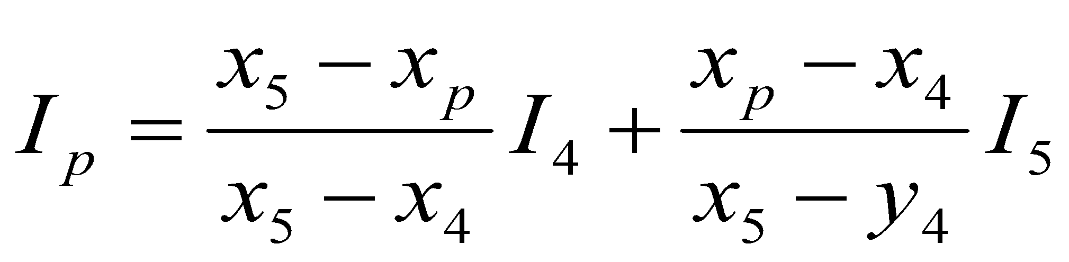
Gouraud Shading (contd…)
N₂
N₃
N₁
Average Unit Normal: Obtained by averaging the surface normals of all polygons sharing the vertex
Intensity interpolation:
Along the polygon edges are obtained by interpolating intensities at the edge ends
Along the scan line between the polygon edges are obtained by interpolating intensities at the intersection of scan line and polygon edges
N₄
V
y
3
1
P
scan line
4
5
2
Recursive calculation along the edge
x
I₁
y
I
scan lines
Recursive Calculation
along the scan line ??
y-1
I’
I₂
x
x+1

Slide 22
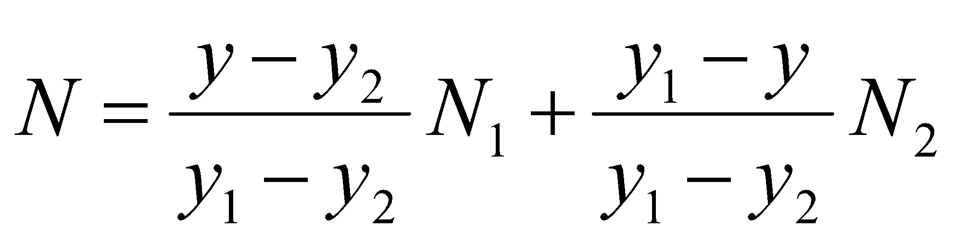
Phong Shading
More accurate method for rendering
Fundamental: Interpolate normal vectors and apply illumination model to each surface point
Calculation steps:
Determine average unit normal vectors at each polygon vertex
Linearly interpolate the vertex normals over the surface of the polygon
Apply an illumination model along each scan line to calculate projected pixel intensities for the surface points
Trade-off: requires considerably more calculations
N₁
(x₃,y₃)
N₃
y
(x₁,y₁)
N
Scan line
(x₂,y₂)
N₂
x
Note: Students are encouraged to read
Fast Phong Shading which could be useful
for project works

